Slide 1
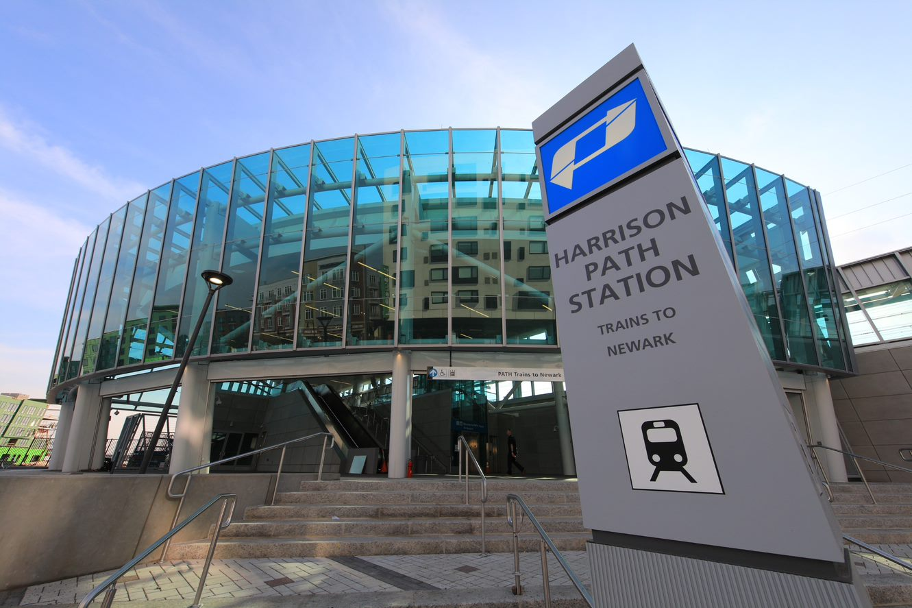

Public Hearings for:
1) Proposed Changes in Tolls, Fares & Other Fees
2) Proposed Changes to the 2017-2026 Capital Plan
July 2019 Public Hearings

Slide 2
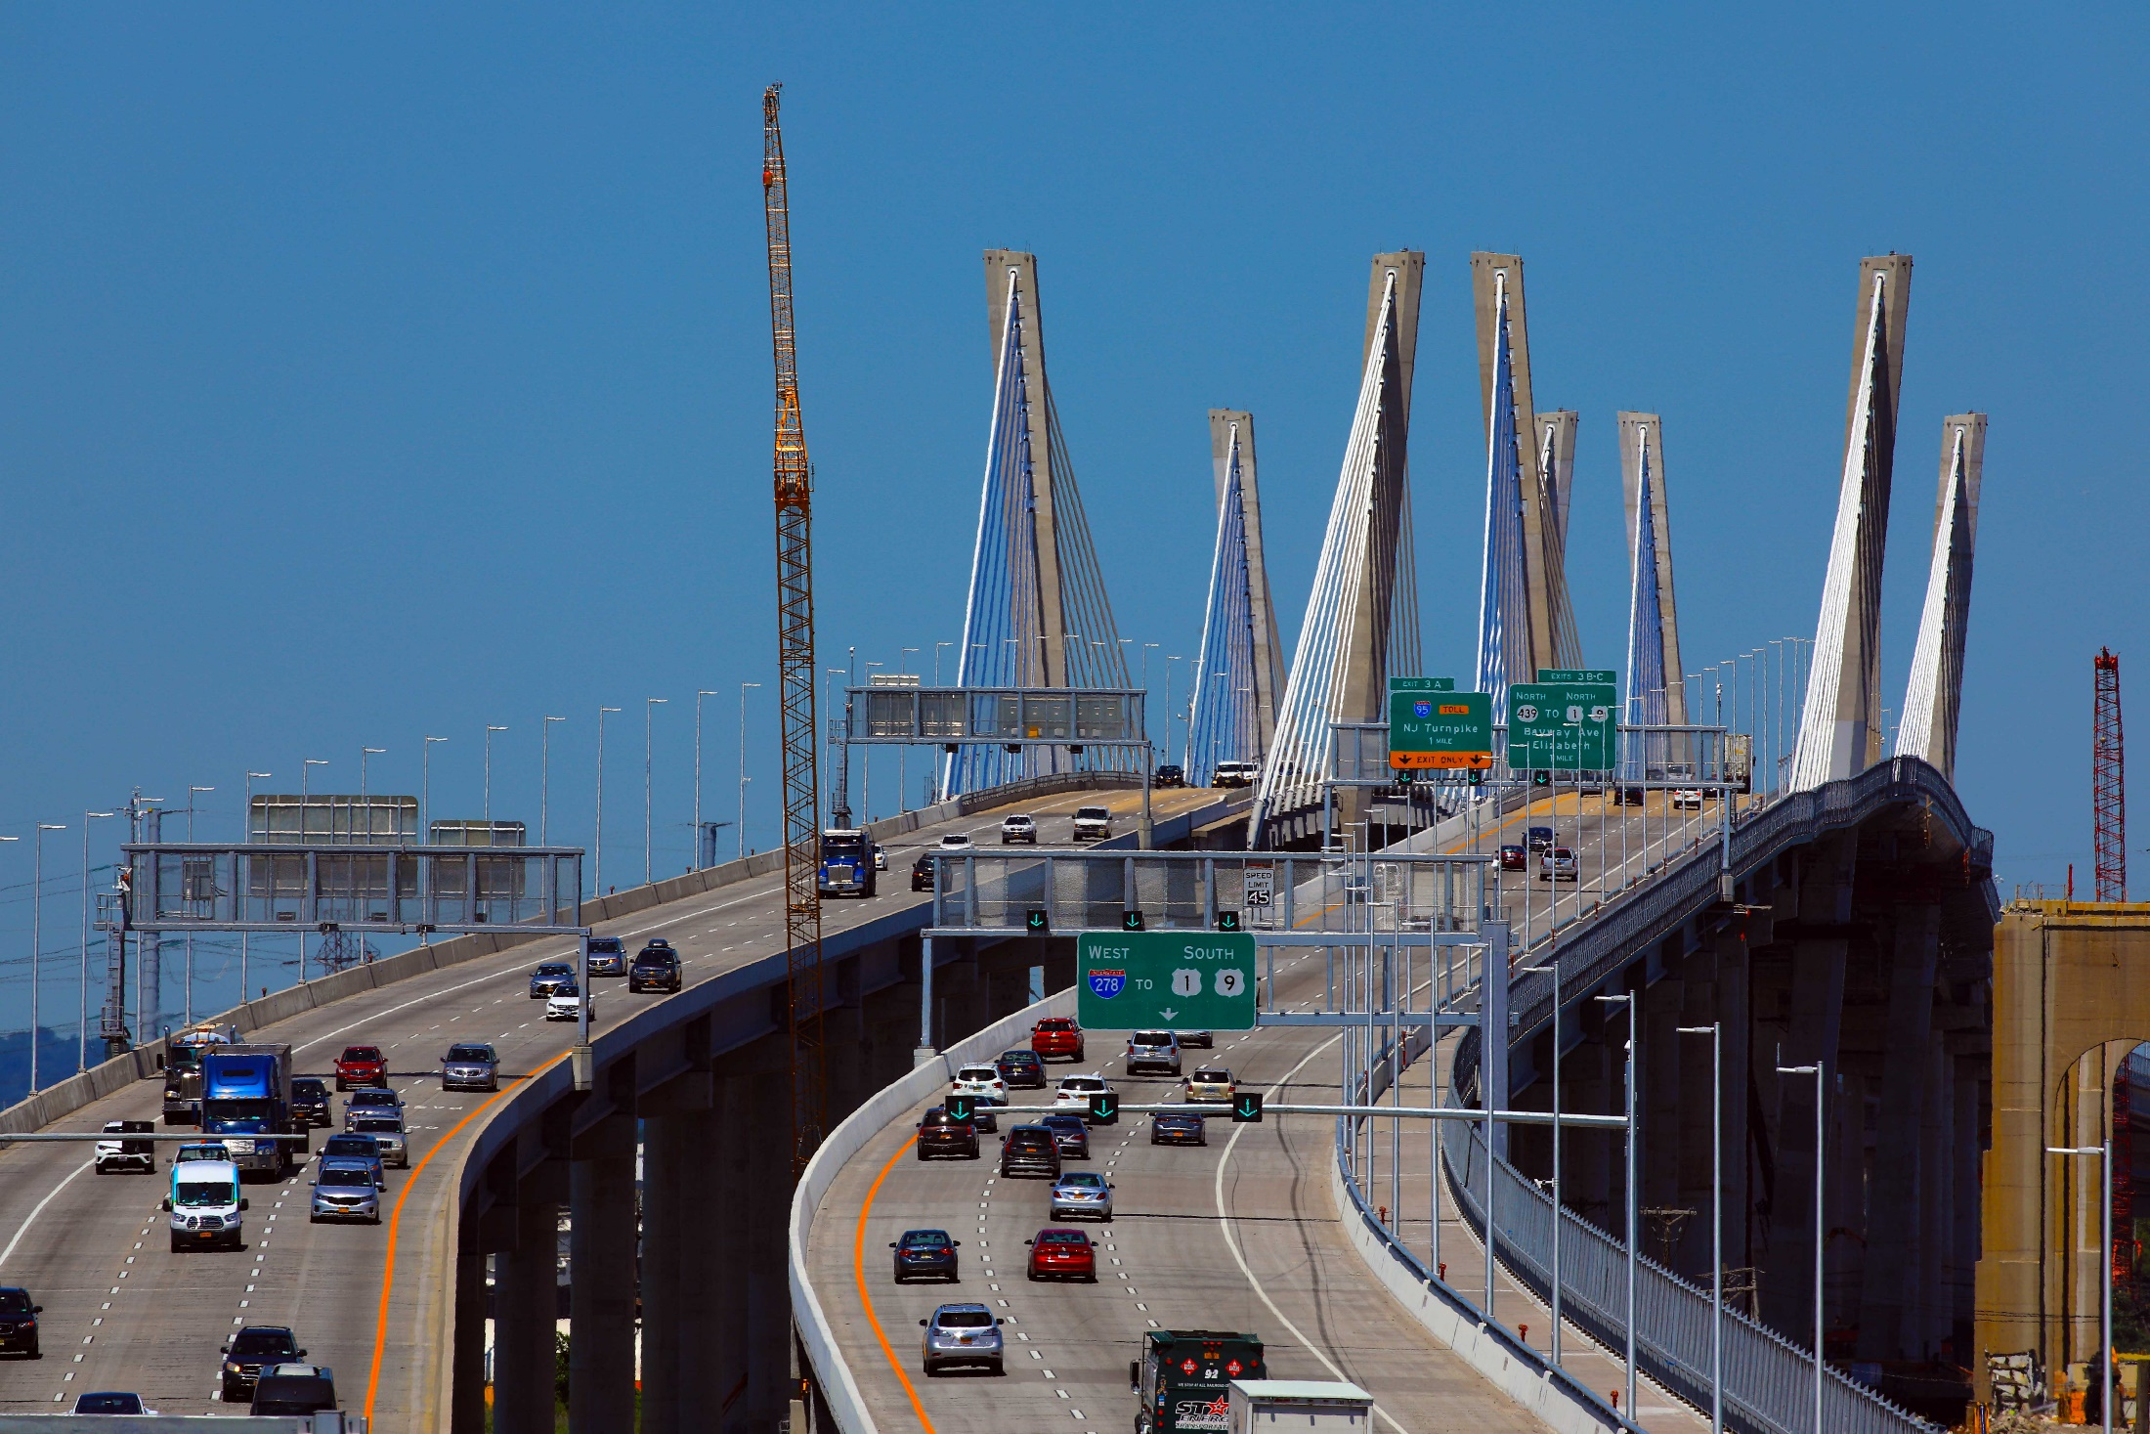
Proposed Changes in Tolls, Fares & Other Fees
http://www.panynj.gov/PublicComments

Slide 3
Unprecedented Investment & Tangible Progress
Unprecedented infrastructure investment at Port Authority facilities fuels the economic engine of an ever-growing region
A half century of neglect and inaction has led to a national infrastructure crisis
The Port Authority’s airports, trains, bridges, tunnels and terminals are vital to the regional and national economy, and are experiencing record, or near record, activity volumes
Therefore, the Port Authority is:
  Working to chart a different path, with the largest capital plan in the agency’s history
  Committed to transform our legacy assets into modern, world-class facilities capable of meeting 21st century expectations
3

Slide 4
Record Volumes Across Facilities
All Port Authority facilities saw record or near-record levels– and volumes continue to grow
Airports Set record passenger volumes each year for the last five years
Ports Achieving record growth; becoming the second busiest port in the nation for the first time in two decades
PATH Five years of consistent growth has led to record PATH ridership
Bridges & Tunnels Handles more than 120 million vehicles each year
AirTrains Ridership at an all-time high
4

Slide 5
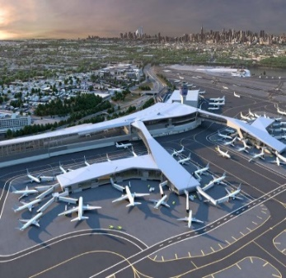
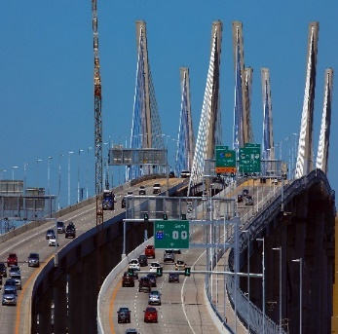

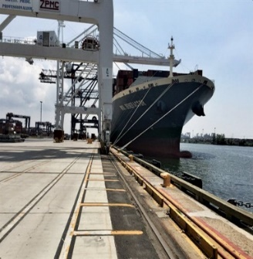
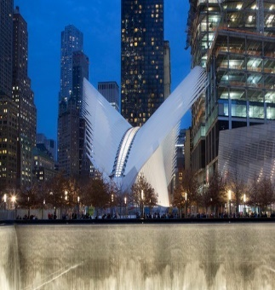
2017-2026 $32.2 Billion Approved Capital Plan*
The approved Capital Plan guides the Port Authority’s investments
Aviation: $11.6B
LGA redevelopment
LGA AirTrain system
EWR Terminal One
JFK Redevelopment
TB&T: $10.0B
Bus Terminal replacement
Goethals Bridge
Bayonne Bridge navigational clearance
GWB restoration program
Lincoln Tunnel Helix replacement
Planning Outerbridge Crossing replacement
PATH: $4.4B
Signal system upgrade
Harrison Station redevelopment
PATH fleet expansion
PATH extension to EWR
Port: $1.1B
Greenville Yard Intermodal container facility
Port Street Corridor
WTC: $1.8B
Completion of:
Site-wide infrastructure
Transportation Hub
Retail complex
*Includes $2.7 billion for the Gateway Development Program
5

Slide 6
Rebuilding, Upgrading & Maintaining Facilities to 21st Century Standards Requires Funding
Inflation-based increases in tolls, fares and other fees are necessary, appropriate and the only responsible course of action
The Port Authority is a self-funded, independent agency that does not rely on taxpayer dollars or funding from the states of New York or New Jersey
The Port Authority works to minimize the need for toll and fare increases
The Port Authority maximizes non-toll and non-fare revenues, and has succeeded with nearly two-thirds of revenues coming from these sources; Nonetheless, these sources are not enough to fully cover the cost of building and operating the agency’s facilities
To maintain the Port Authority’s unprecedented investment and tangible progress, additional funding is required from tolls, fares and other fees, which have not increased in years and are not keeping pace with inflation
6

Slide 7
Capital Plan Assumed Certain Revenue Actions
Prior Board actions mandated automatic inflation adjustments and contemplated future Board action to ensure revenues were sufficient to deliver on the 2017-2026 Capital Plan
The proposed changes keep pace with inflation, are consistent with peer agencies, and remain true to prior Board actions. The changes address:
  Bridge and tunnel tolls
  PATH fares
  AirTrain fares, and
  A new airport ground transportation access fee
The proposed changes are estimated to generate $235 million of incremental annual net revenue
7

Slide 8
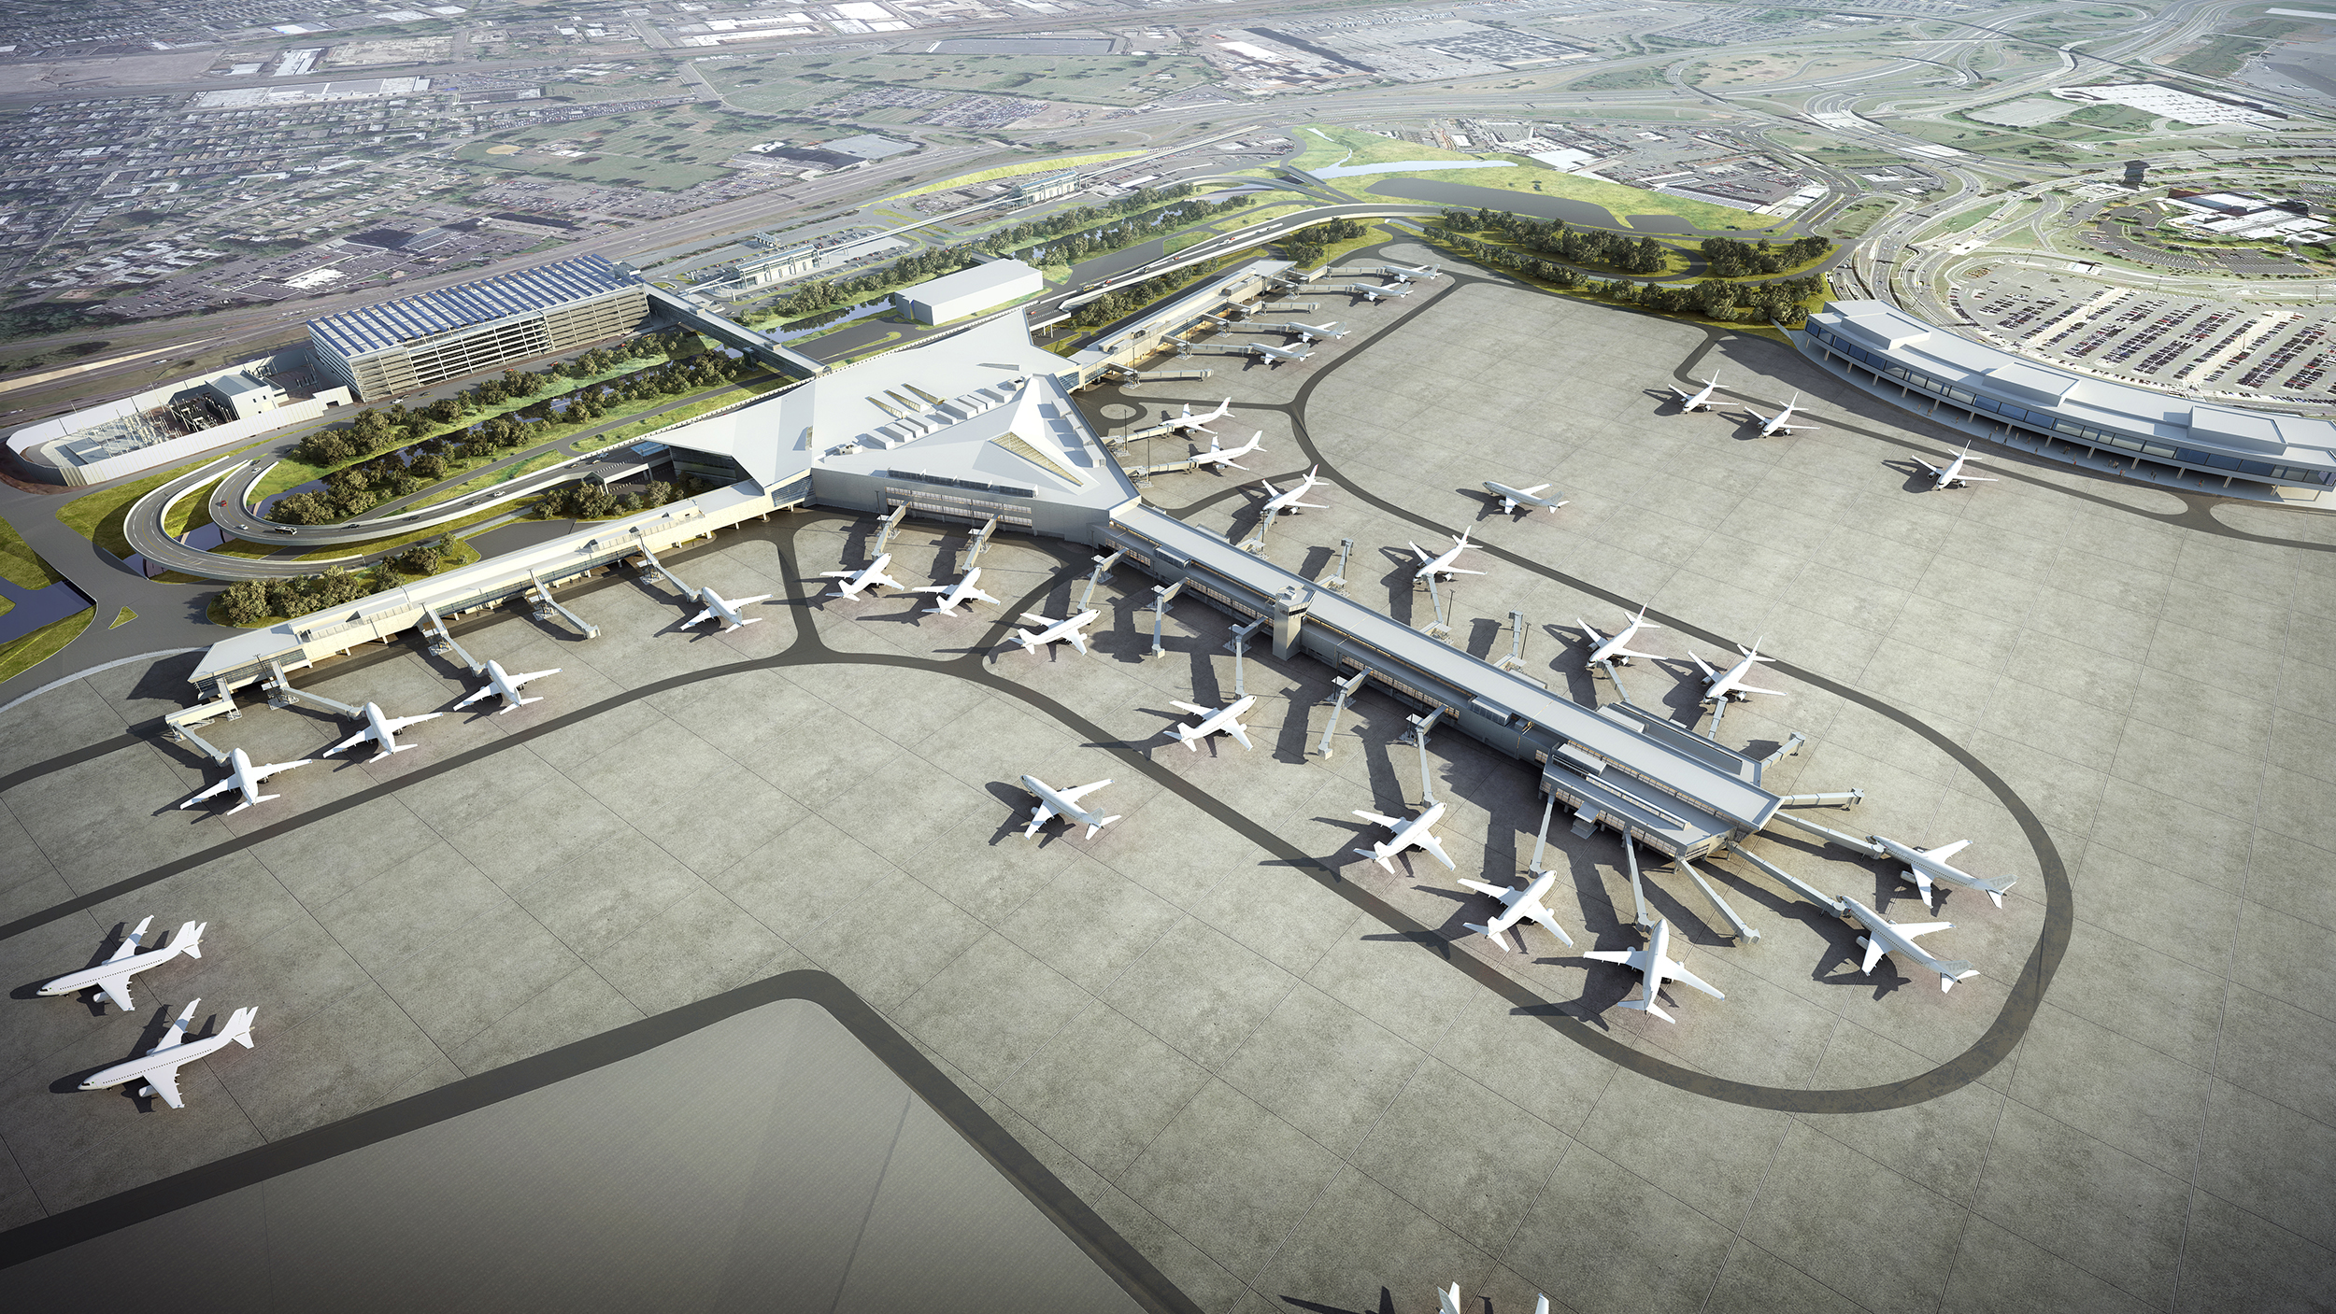
Proposed Changes to the 2017-2026 Capital Plan
http://www.panynj.gov/PublicComments

Slide 9
2017-2026 Capital Plan Reassessment
  The 2017-2026 Capital Plan is a blue-print for spending in the period
  The Board required a reassessment of the Capital Plan every two years
  The Board required the reassessment to:
    Review progress and account for changed circumstances
    Assure State of Good Repair (SGR) Assessment validity
    Confirm capital capacity
    Account for actions already taken by the Board
9

Slide 10
2017-2026 Capital Plan Reassessment
Plan proposed to increase by $4.8 billion to $37 billion
94% of increase ($4.5 billion) funded by revenue associated with specific projects
Revenue Sources of $4.8 billion
10

Slide 11
2017-2026 Capital Plan Increases
Project ($ in millions) | Increase | Reassessed Plan
Major Projects
New AirTrain Newark | $1,640 | $2,050
JFK Redevelopment | 1,900 | 2,900
AirTrain LGA | 390 | 2,050
Newark Terminal One Redevelopment | 350 | 2,700
New Projects
PATH Improvement Plan | 200 | 200
Electric Vehicle (EV) Infrastructure | 50 | 50
EWR Terminal Two Redevelopment Planning | 35 | 35
Remaining Projects | 235 | 27,015
Net Total | $4,800 | $37,000
New Projects in Bold
11

Slide 12
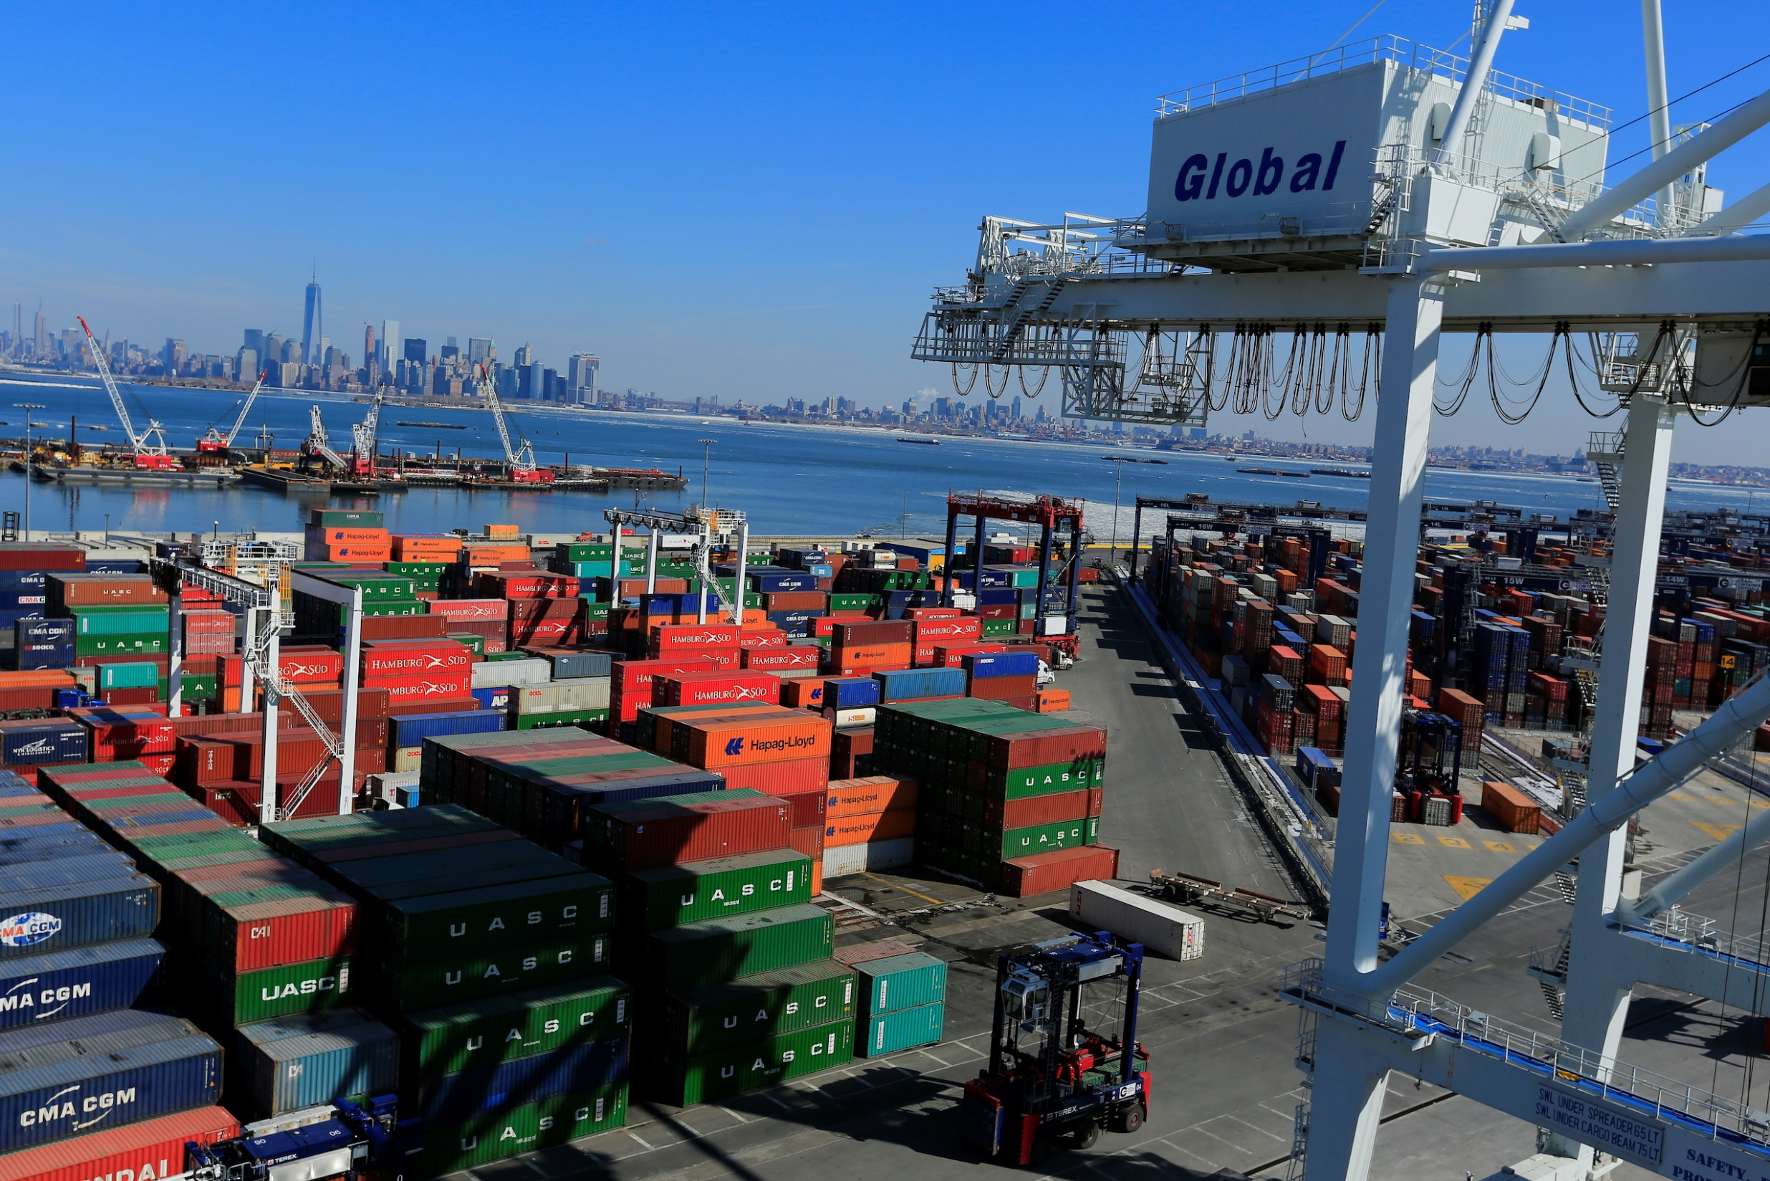
The Port Authority Board values your input.
Comments can be submitted:
1) In person at the Public Hearings
2) Online at: http://www.panynj.gov/PublicComments
3) Through the mail, addressed to:
Public Hearing Comments
4 World Trade Center
150 Greenwich St, 23rd Floor
New York, NY 10007
Written comments will be accepted through 11:59 p.m., September 13, 2019

Slide 13
Unprecedented Investment in 21st Century Infrastructure

